Slide 1
Cricket Score Prediction
By
- Abhishek Kamtekar
- Pratik Shinde

Slide 2
Introduction
We are going to predict first innings score on the basis of a dataset of IPL which contains data from first match played since 2008
We are going to predict the score on the basic of this dataset and taking the first 5 overs data from current match to make it more accurate

Slide 3
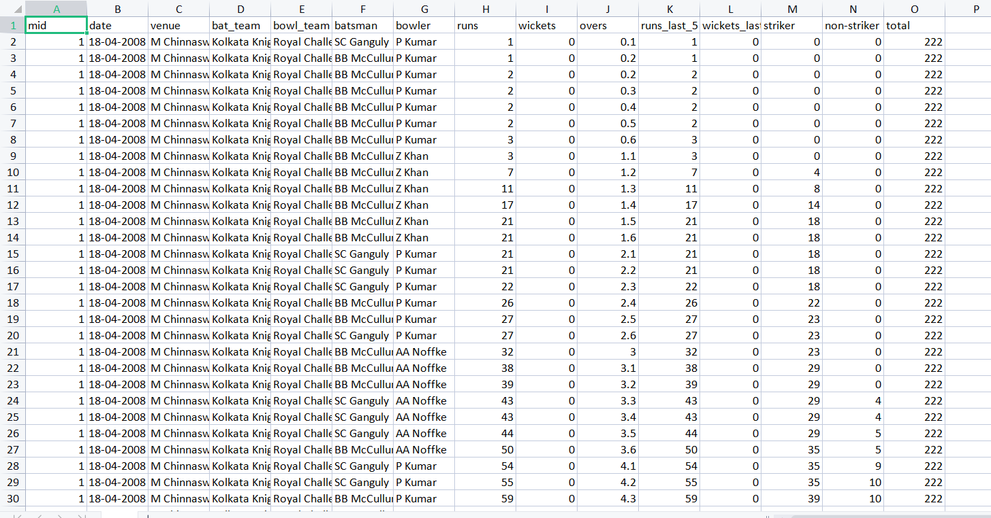
Dataset
We have used IPL dataset from kaggle.com
Which includes data points such as date,venue,batting team,bowling team and match information by per ball bowled since 2008

Slide 4
Algorithms we are going to use
Linear Regression
Ridged Regression
Lasso Regression

